Slide 1

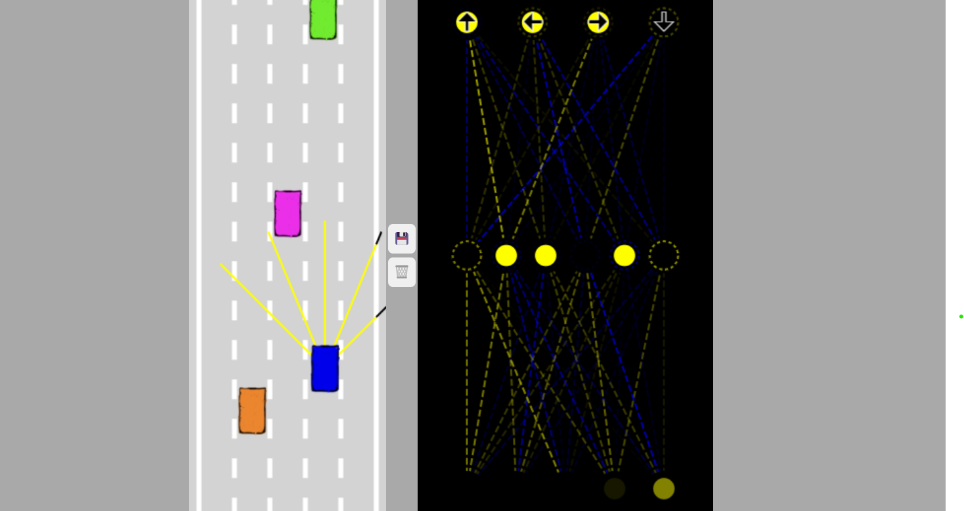
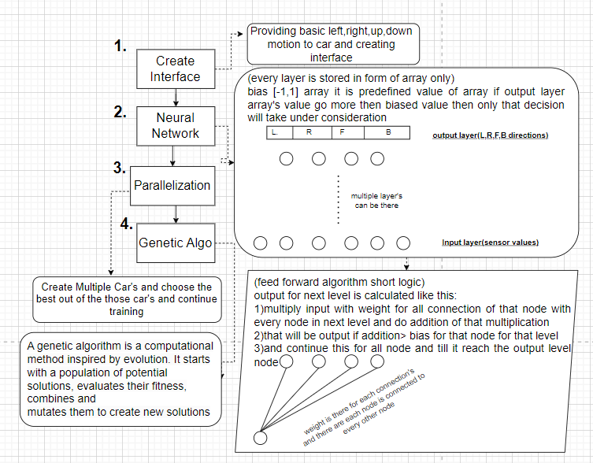
Department of Computer Engineering
Course Code CSM 501 Mini Project: 2 A
Academic Year 2023-2024
Title : Self Driving Car(Virtual)
Group ID.: T09
Member : Deep Salunkhe
Member : Pranav Redij
Member : Sukant Thombare
Member : Omkar Patil
Guide : Avinash Shrivas
Abstract
Methodology :
Results
In this project, we've built a virtual self-driving car. We all know that AI is changing the way we live, especially in transportation. Self-driving vehicles are becoming more common, and AI, like neural networks, is the brain behind them.
Training AI to drive a real car is expensive and not very practical. So, we've chosen a different path. We've trained our AI in a virtual world.
This project is all about teaching AI to drive safely in a computer-simulated world. We're preparing AI for the future of self-driving cars, and this project is a step in that direction.
Environment Setup: Created the simulation environment using HTML, CSS, and canvas.
Car Development: Defined car properties and controls in JavaScript.
Sensor Integration: Added sensors for object detection and implemented collision detection.
Neural Network Introduction: Introduced neural networks for decision-making, inspired by the human brain.
Neural Network Construction : Developed a neural network with input and output layers, weights, and biases.
Sensor-Network Connection : Integrated car sensors with the neural network, adjusting inputs to represent object proximity.
Visualization and Debugging : Implemented a visualization canvas to aid in network debugging.
Parallelization and Traffic : Extended the simulation to multiple cars and introduced traffic interactions.
Network Saving and Mutation : Saved best car network data in JSON format and introduced network mutation for innovation.
Collision Avoidance: The self-driving car successfully learned collision avoidance strategies, ensuring safe navigation in traffic scenarios.
Adaptive Learning: The neural network demonstrated adaptive learning, allowing the car to adjust its behavior based on real-time sensor inputs and changing traffic conditions.
Optimal Car Selection: The implemented algorithms facilitated the selection of the best-performing car, ensuring that the car with the highest fitness and ability to navigate traffic was preserved for future use.
Scalability: The project's architecture proved to be scalable, accommodating the training of multiple cars in parallel, making it possible to experiment with various car behaviors and strategies simultaneously.
Genetic Algorithm Impact: Genetic algorithms played a vital role in optimizing car behaviors, resulting in improved performance over time and under different scenarios.
Future Potential: The successful implementation of these techniques lays the foundation for further developments in autonomous vehicles, potentially leading to more complex actions like lane following and parking.
Introduction
Our project introduces neural networks as the decision-making brain of our self-driving car. We employ a straightforward feed-forward algorithm to enable data transfer between network layers, empowering our car to navigate autonomously.
To expedite the process of finding the best-performing car, we implement parallelism and mutation techniques. This approach allows multiple cars to be tested simultaneously and their neural networks adjusted, leading to quicker and more efficient results.
Notably, we opt for manual data storage rather than the backpropagation algorithm. JavaScript is our language of choice, facilitating the entire process. Our project showcases the exciting potential of AI in redefining transportation.
Flow Diagram
Literature Survey
Conclusion
Current State of the Self-Driving Car Industry
The autonomous vehicle industry has seen significant investment and advancements, but it’s also faced challenges and setbacks. Currently, there are no companies that can offer a fully autonomous ride in any conditions, on any road, without a human overseer1. The leaders in autonomous driving have achieved Level 4 technology, but only along pre-defined routes under specific circumstances1. Self-driving cars that the public can actually buy and use are still firmly at Level 3 technology1.
The market is shifting from robo-taxis to automated trucks and delivery vehicles2. This shift is due to difficulties in commercializing Mobility as a Service (MaaS), technological hurdles, and changes in market demand caused by the COVID-19 pandemic2.
Importance of Virtual Environments in Training AI for Self-Driving Cars
Virtual environments play a crucial role in training the AI used in self-driving cars. They make training safer and more efficient by allowing the vehicles to think they’re on public roads when they’re really in controlled environments. This approach eliminates the risk of property damage or loss of life during on-road training.
Virtual environments can simulate countless variables that an AI would encounter on actual roads, such as construction, pedestrians, erratic human drivers, inclement weather, and other road hazards. This method saves time, money, and eliminates the risk of fatal traffic accidents.
Conclusion
The development of self-driving cars using JavaScript presents an opportunity to contribute to this rapidly evolving field. By leveraging virtual environments for training, we can improve the safety and efficiency of developing autonomous vehicle technology.
Our project has been a journey of exploration and learning in the amazing world of self-driving car development. While we are proud of our achievements, we approach our results with humility, acknowledging that there is much more to discover and refine in this complex field.
One of our key accomplishments has been the successful implementation of a neural network that allows a car to navigate traffic without collisions. This achievement underscores the potential of machine learning and artificial intelligence in the realm of autonomous vehicles.
In journey, we have also implemented mutation algorithms and parallel processing techniques to optimize the learning process. These additions have allowed us to identify and save the best-performing cars, bringing us closer to creating more intelligent and adaptive self-driving vehicles.
Our exploration of genetic algorithms has enriched our understanding of how cars can evolve and improve over time. The simulation environment we've created mimics real-world driving situations, reminding us of the intricacies and challenges that must be overcome to achieve true autonomous driving.
As we reflect on our work, we recognize that our project is just a small step in the long journey toward self-driving cars. The path ahead is filled with exciting possibilities, and we approach it with the humility to learn from our achievements and shortcomings alike.
In closing, we embrace the knowledge that there is much more to uncover in the development of self-driving cars. Our project stands as a testament to the potential of technology, and we look forward to the ongoing exploration and innovation in this field, remaining humble in the face of the challenges that lie ahead.
Experimental Details
The self-driving car simulation project is developed entirely in JavaScript, emphasizing the use of modern JavaScript techniques. No external libraries were utilized. The software used included a code editor for JavaScript development.
Data Collection
Data collection in the experiment revolved around capturing various parameters related to the self-driving car's behavior within the simulated environment. This data encompassed sensor inputs, control commands, and neural network parameters, enabling the evaluation of the car's performance under different conditions.
Experimental Design
The primary objectives of the experiments were to simulate the self-driving car's behavior in a variety of scenarios. These scenarios were designed to test the car's ability to navigate digital roads, avoid obstacles, and interact with simulated traffic.
Scenarios
The designed scenarios covered aspects such as road layouts, obstacles, traffic conditions, and complex road borders. These scenarios aimed to assess the adaptability and learning capabilities of the self-driving car within the simulation.
Simulation Components
1. Physics and Control
2. Road and Border Creation
3. Sensor Implementation
4. Collision Detection
5. Neural Network Integration
.
References
Objectives
Neural Networks in JavaScript
www.freecodecamp.org
https://www.ibm.com/topics/neural-networks
https://www.freecodecamp.org/news/how-to-create-a-neural-network-in-javascript-in-only-30-lines-of-code-343dafc50d49/
https://www.youtube.com/watch?v=aircAruvnKk
https://www.youtube.com/watch?v=ER2It2mIagI
To Implement the Neural network using JavaScript
Creating a brain that can run on the virtual path without hitting any other car
Visualizing the neural network to see how is it working
Understanding the mathematical significance of neural network

